Slide 1
Unified Modeling Language (UML) Basics
Class Diagrams

Slide 2
Unified Modeling Language (UML)
UML is a standardized way of representing a design
There are many types of diagrams: each one represents either
Processes, with “Behavior Diagrams”
Sequence Diagrams
Collaboration Diagrams
Use Case Diagrams
or
Classes and relationships, with “Structure Diagrams”
We will focus on class diagrams

Slide 3
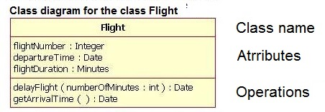


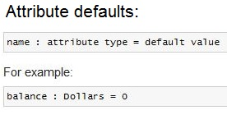
Class Diagrams
Each class is represented with a rectangle in three compartments: class name, attributes, and operations.

Slide 4
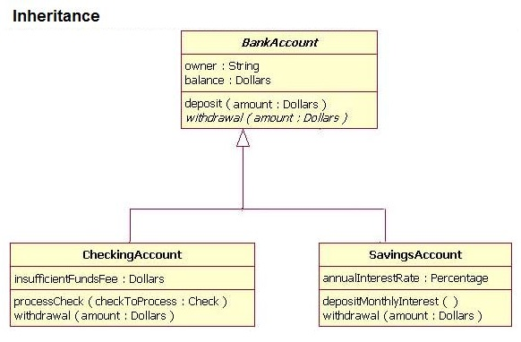
Representing Inheritance

Slide 5
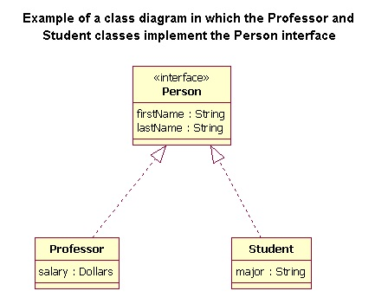
Representing Interfaces

Slide 6
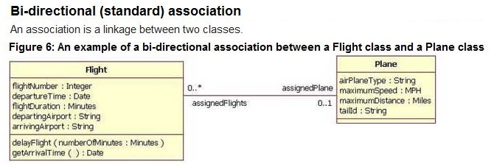
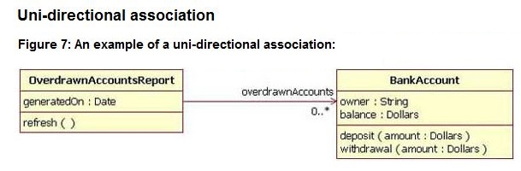
Association between Classes

Slide 7
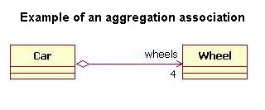
Aggregation

Slide 8
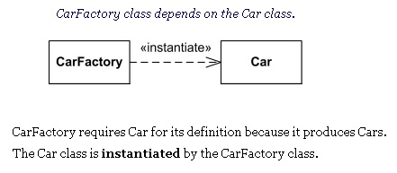
Dependency

Slide 9
Drawing Class Diagrams
In each assignment you will be required to submit a class diagram (normally not including GUI classes)
Several Options:
Draw them by hand, scan and submit in Blackboard
Download Nclass (free at http://nclass.sourceforge.net/ )
Allows you to draw a class diagram
Simple to use
Does not create a class diagram from your code
Download Class Visualizer (free at http://www.class-visualizer.net/)
Allows you to import your code and create a class diagram
Quite complicated to use
…use other applications, including some you can plug in to Eclipse

Slide 10
ObjectAid UML Tool
ObjectAid is a free tool that works right from Eclipse
To install in Eclipse:
Open Eclipse and go to Help > Install New Software
Click on add to add a new repository
Enter name: ObjectAid UML Explorer
Enter Location: http://www.objectaid.net/update
Select the ObjectAid Class Diagram plugin
Click Finish
Click Ok on the security warning
Select Restart Now
To draw a class diagram:
File > New > Other > type Class Diagram
Drag-and-drop .java files into the diagram

